Slide 1

Value Function Approximation
Bellman 方程/Bellman最优方程 -> v(s),q(s,a) ➔ 评估当前策略
利用q(s,a) upgrade 策略 ➔ 优化更新策略
2023/5/8
MICL in USTB

Slide 2

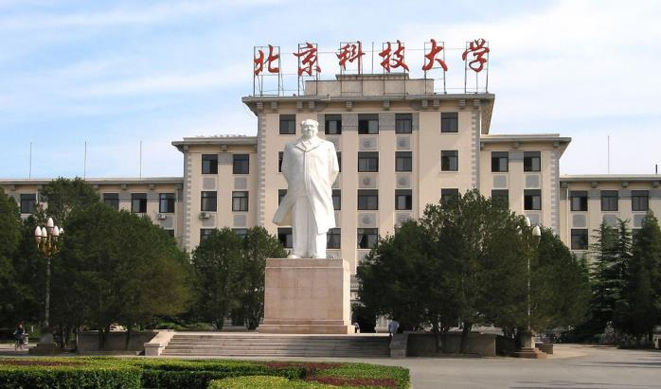

1
Motivating Examples: curve fitting
2*
Algorithm for state value estimation
3
Sarsa with function approximation
4
Q-learning with function approximation
5
Deep Q-Leaning
6
Summary

Slide 3
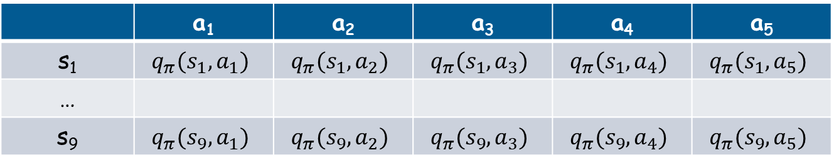
Motivating examples: curve fitting
So far in this course, state and action values are represented by tables
For examples, action value:
Advantage: intuitive and easy to analyze
Disadvantage: difficult to handle large or continuous state or action spaces. Two aspects: 1) storage; 2) generalization
 | a₁ | a₂ | a₃ | a₄ | a₅
s₁ | $$q_{π}(s_{1},a_{1})$$ | $$q_{π}(s_{1},a_{2})$$ | $$q_{π}(s_{1},a_{3})$$ | $$q_{π}(s_{1},a_{4})$$ | $$q_{π}(s_{1},a_{5})$$
…
s₉ | $$q_{π}(s_{9},a_{1})$$ | $$q_{π}(s_{9},a_{2})$$ | $$q_{π}(s_{9},a_{3})$$ | $$q_{π}(s_{9},a_{4})$$ | $$q_{π}(s_{9},a_{5})$$

Slide 4
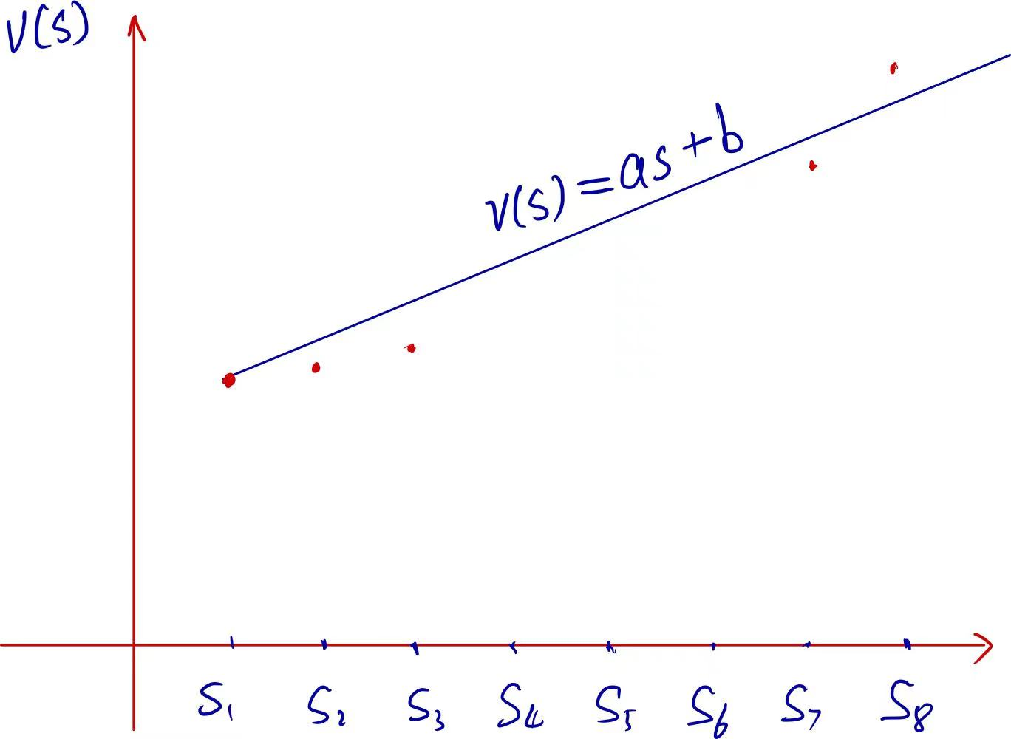
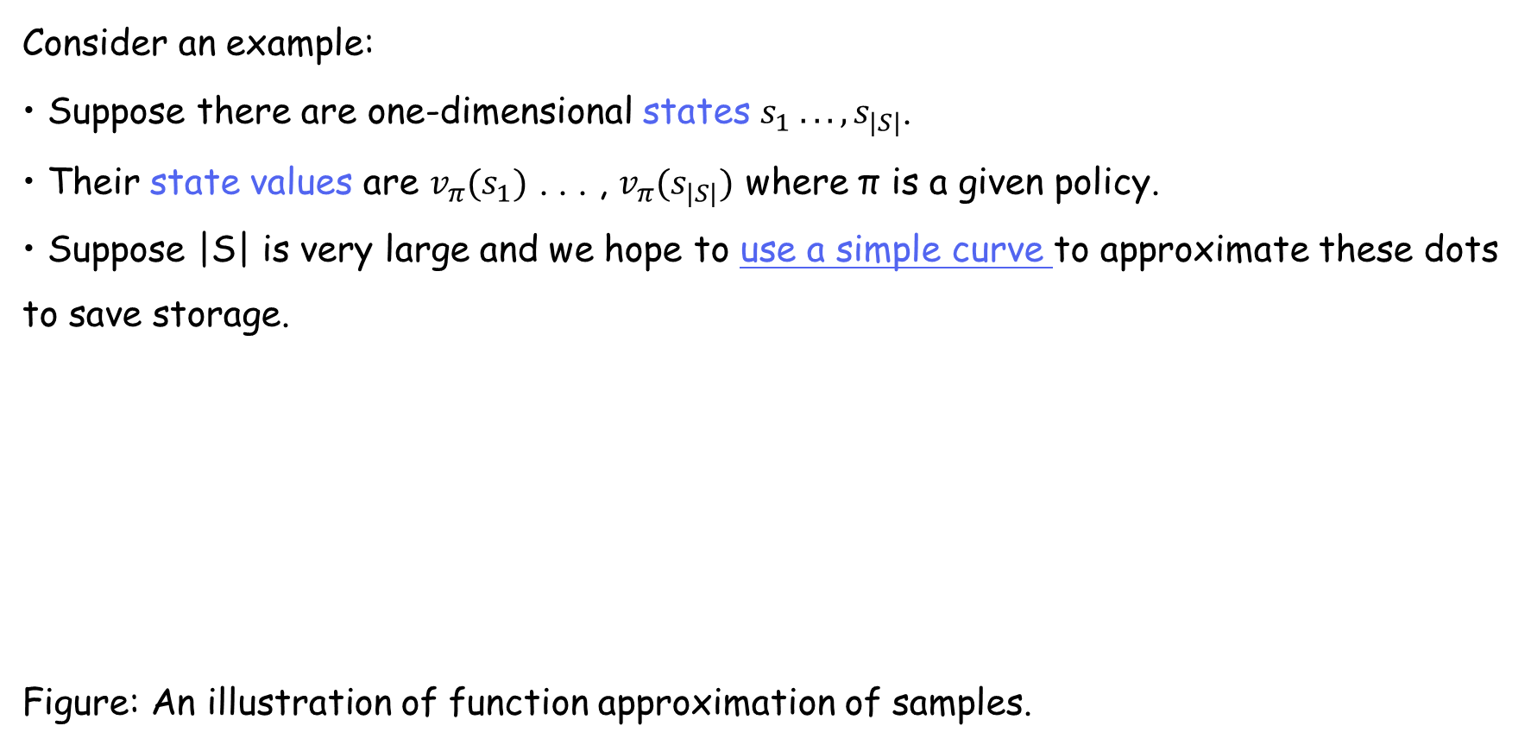
Motivating examples: curve fitting
Consider an example: • Suppose there are one-dimensional states $s_{1} . . . ,s_{|S|}$. • Their state values are $v_{π}(s_{1})$ . . . , $v_{π}(s_{|S|})$ where π is a given policy. • Suppose |S| is very large and we hope to use a simple curve to approximate these dots to save storage.
Figure: An illustration of function approximation of samples.

Slide 5
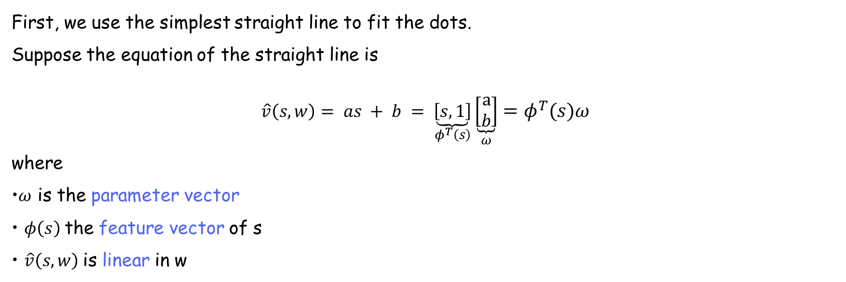
Motivating examples: curve fitting
First, we use the simplest straight line to fit the dots. Suppose the equation of the straight line is $$\hat{v}\left(s, w\right)= as + b = \underset{φ^{T}\left(s\right)}{\underbrace{\left[s,1\right]}}\underset{ω}{\underbrace{\left[\begin{matrix}a \\ b\end{matrix}\right]}}=φ^{T}\left(s\right)ω$$ where •$ω$ is the parameter vector • $φ\left(s\right)$the feature vector of s • $\hat{v}\left(s, w\right)$is linear in w

Slide 6
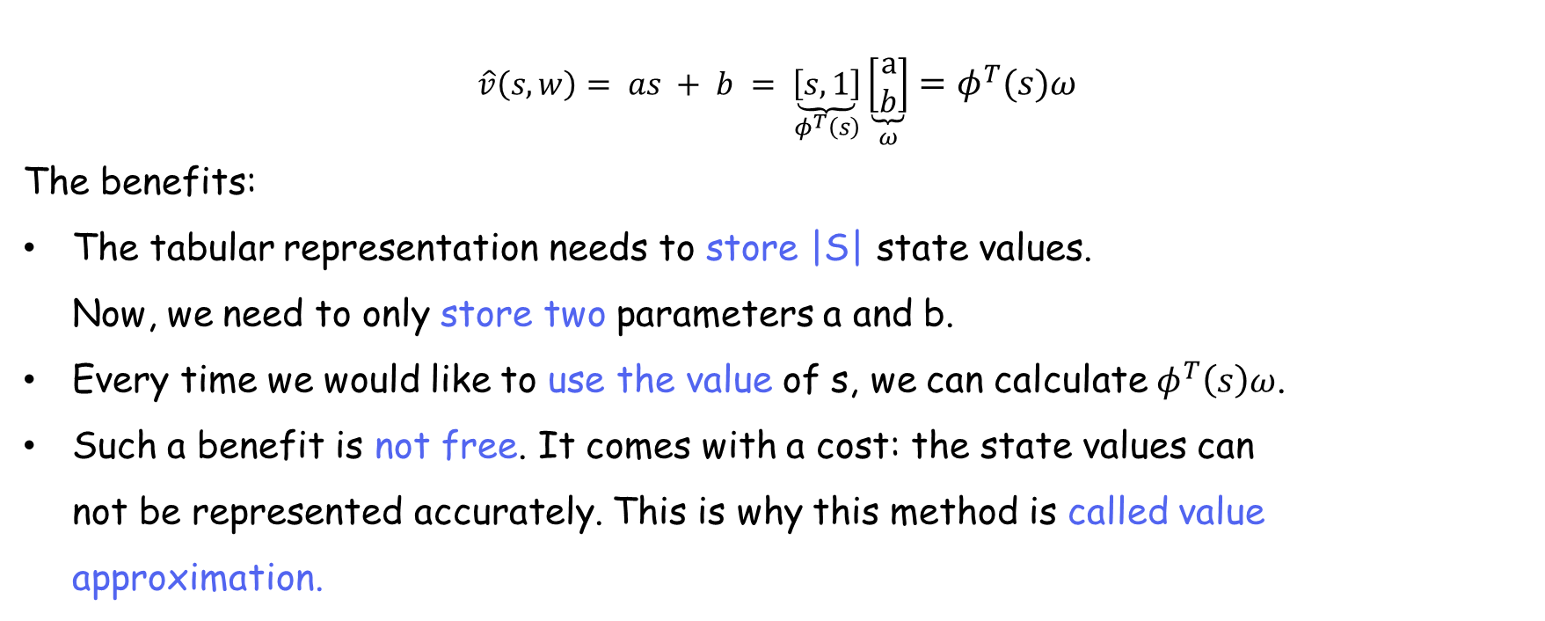
Motivating examples: curve fitting
$$\hat{v}\left(s, w\right)= as + b = \underset{φ^{T}\left(s\right)}{\underbrace{\left[s,1\right]}}\underset{ω}{\underbrace{\left[\begin{matrix}a \\ b\end{matrix}\right]}}=φ^{T}\left(s\right)ω$$ The benefits:
The tabular representation needs to store |S| state values. Now, we need to only store two parameters a and b.
Every time we would like to use the value of s, we can calculate $φ^{T}\left(s\right)ω$.
Such a benefit is not free. It comes with a cost: the state values can not be represented accurately. This is why this method is called value approximation.

Slide 7
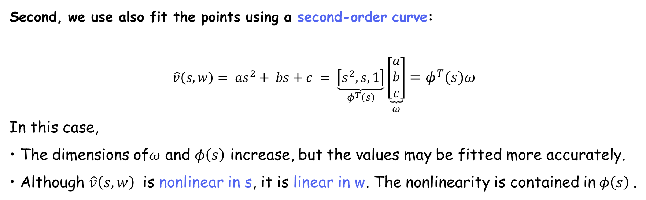
Motivating examples: curve fitting
Second, we use also fit the points using a second-order curve: $$\hat{v}\left(s, w\right)= as^{2}+ bs+c = \underset{φ^{T}\left(s\right)}{\underbrace{\left[s^{2},s,1\right]}}\underset{ω}{\underbrace{\left[\begin{matrix}a \\ b \\ c\end{matrix}\right]}}=φ^{T}\left(s\right)ω$$ In this case, • The dimensions of$ω$ and $φ\left(s\right)$ increase, but the values may be fitted more accurately. • Although $\hat{v}\left(s, w\right)$ is nonlinear in s, it is linear in w. The nonlinearity is contained in$φ\left(s\right)$.

Slide 8
Motivating examples: curve fitting
Third, we can use even higher-order polynomial curves or other complex curves to fit the dots. • Advantage: It can better approximate. • Disadvantage: It needs more parameters.

Slide 9
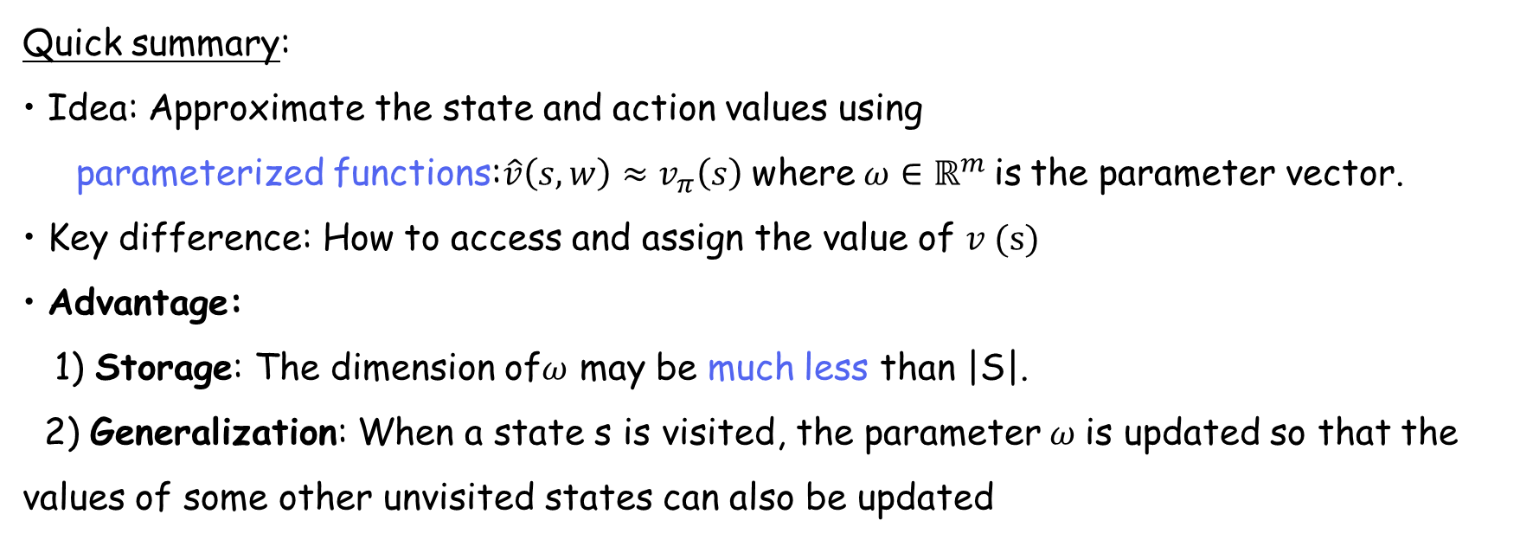
Motivating examples: curve fitting
Quick summary: • Idea: Approximate the state and action values using parameterized functions:$\hat{v}\left(s, w\right)≈v_{π}\left(s\right)$ where$ω∈ℝ^{m}$is the parameter vector. • Key difference: How to access and assign the value of $v (s)$ • Advantage: 1) Storage: The dimension of$ω$ may be much less than |S|. 2) Generalization: When a state s is visited, the parameter$ω$ is updated so that the values of some other unvisited states can also be updated

Slide 10
1
Motivating Examples: curve fitting
2
Algorithm for state value estimation
Objective function
Optimization algorithm
Selection of function approximators
Illustrative examples
Summary of the story
Theoretical analysis
3
Sarsa with function approximation
4
Q-learning with function approximation
5
Deep Q-Leaning
6
Summary

Slide 11
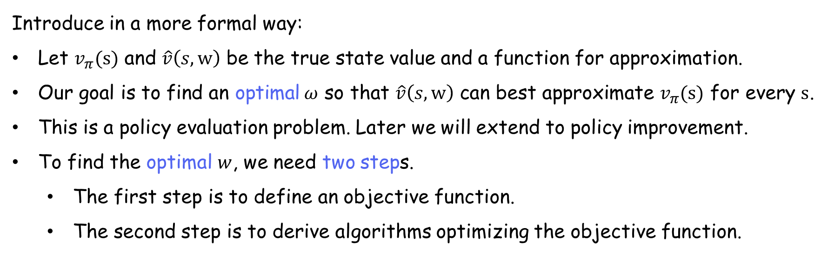
Objective function
Introduce in a more formal way:
Let $v_{π}(s)$ and $\hat{v}\left(s,w\right)$ be the true state value and a function for approximation.
Our goal is to find an optimal$ω$ so that $\hat{v}\left(s,w\right)$ can best approximate $v_{π}(s)$ for every $s$.
This is a policy evaluation problem. Later we will extend to policy improvement.
To find the optimal $w$, we need two steps.
The first step is to define an objective function.
The second step is to derive algorithms optimizing the objective function.

Slide 12
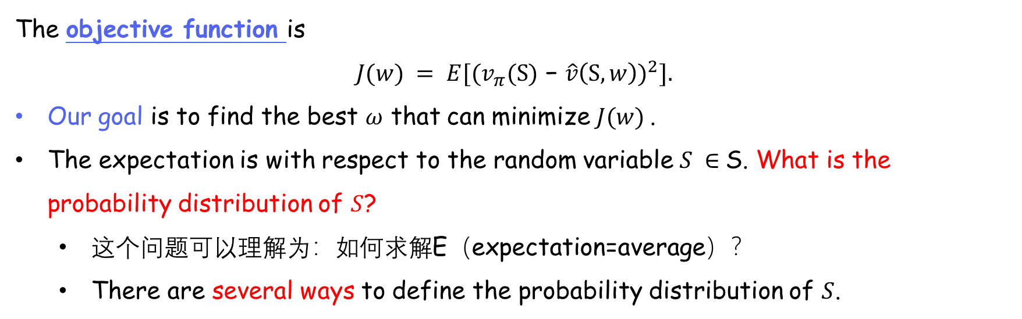
Objective function
The objective function is $$J(w) = E[{(v_{π}(S)\text{ − }\hat{v}\left(S,w\right))}^{2}].$$
Our goal is to find the best $ω$ that can minimize $J(w)$.
The expectation is with respect to the random variable $S ∈$S. What is the probability distribution of $S$?
这个问题可以理解为：如何求解E（expectation=average）？
There are several ways to define the probability distribution of $S$.

Slide 13
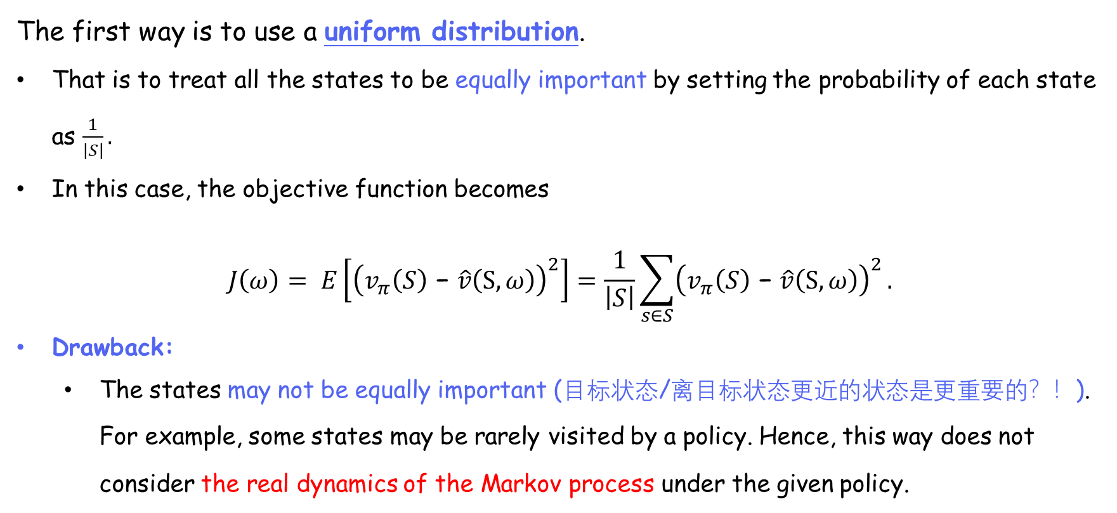
Objective function
概率->可能性->重要性
UD: Given a policy, all the states 出现的可能性一样！
The first way is to use a uniform distribution.
That is to treat all the states to be equally important by setting the probability of each state as $\frac{1}{\left|S\right|}.$
In this case, the objective function becomes
$$J\left(ω\right)= E\left[{\left(v_{π}\left(S\right)\text{ − }\hat{v}\left(S,ω\right)\right)}^{2}\right]=\frac{1}{\left|S\right|}\sum_{s∈S}{{\left(v_{π}\left(S\right)\text{ − }\hat{v}\left(S,ω\right)\right)}^{2}}.$$
Drawback:
The states may not be equally important (目标状态/离目标状态更近的状态是更重要的？！). For example, some states may be rarely visited by a policy. Hence, this way does not consider the real dynamics of the Markov process under the given policy.
Notes:
不同的重要性表示为不同的权重，重要的状态，最好误差要小；不重要的状态，误差大些没有关系，因为可能不会访问/很少访问！

Slide 14
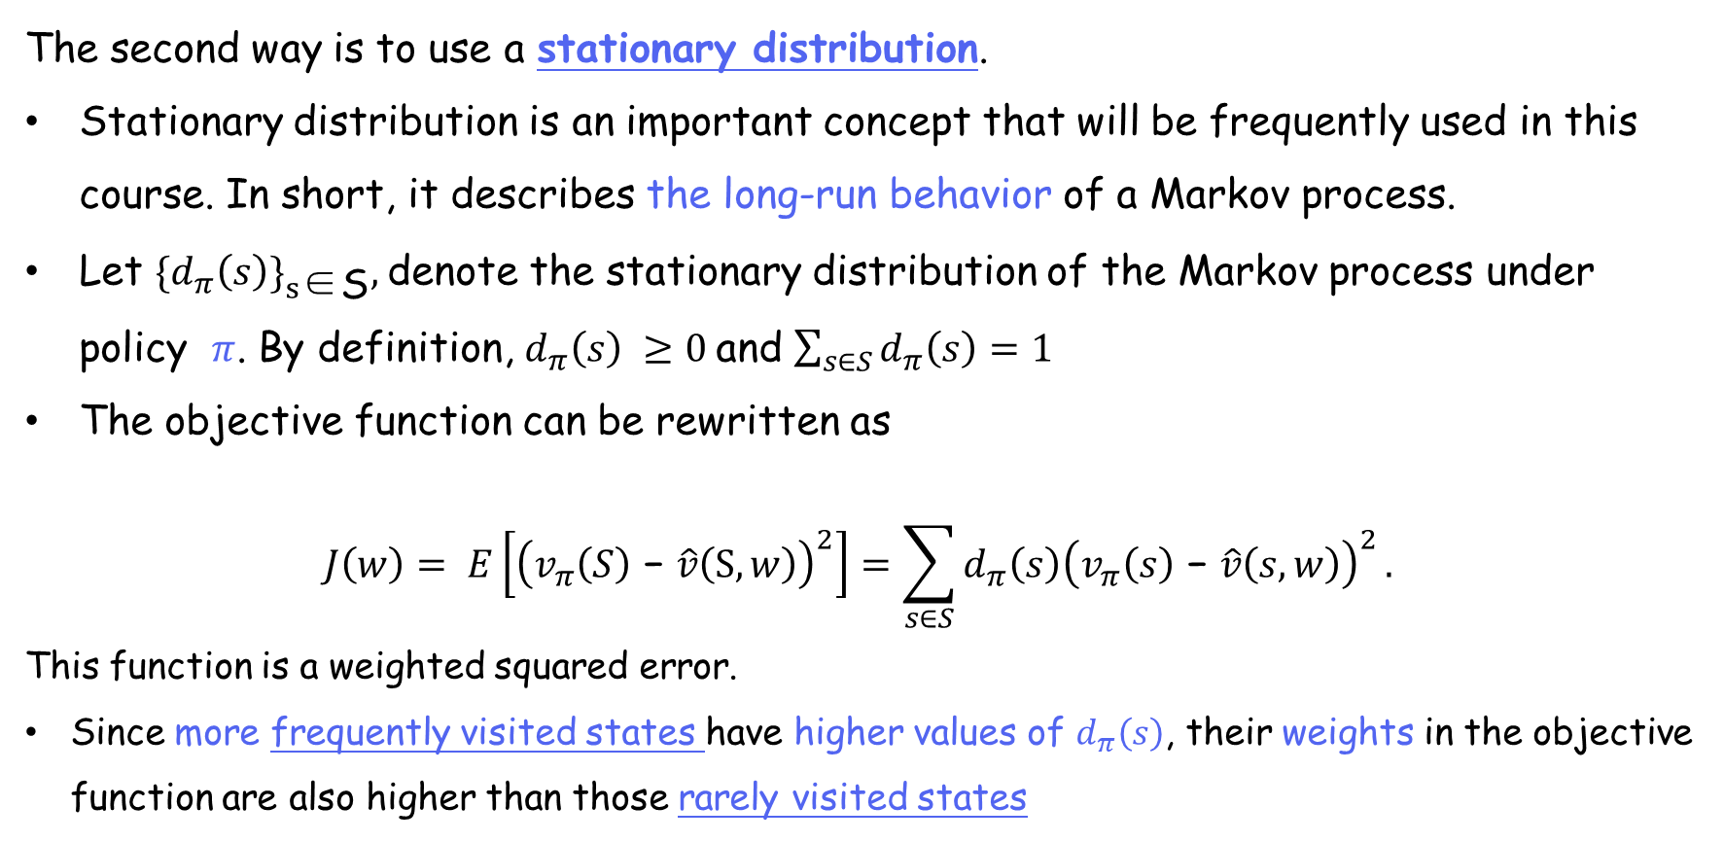
Objective function
Given a policy, 经过长时间运行(long-run behavior)，状态被访问的比例达到“平稳stationary”。
The second way is to use a stationary distribution.
Stationary distribution is an important concept that will be frequently used in this course. In short, it describes the long-run behavior of a Markov process.
Let ${{\{d}_{π}\left(s\right)\}}_{s\text{∈}\text{S}},$denote the stationary distribution of the Markov process under policy $π$. By definition, $d_{π}\left(s\right) ≥0$and $\sum_{s∈S}{d_{π}\left(s\right)}=1$
The objective function can be rewritten as
$$J\left(w\right)= E\left[{\left(v_{π}\left(S\right)\text{ − }\hat{v}\left(S,w\right)\right)}^{2}\right]=\sum_{s∈S}{d_{π}\left(s\right){\left(v_{π}\left(s\right)\text{ − }\hat{v}\left(s,w\right)\right)}^{2}}.$$
This function is a weighted squared error.
Since more frequently visited states have higher values of $d_{π}\left(s\right)$, their weights in the objective function are also higher than those rarely visited states

Slide 15
Objective function - stationary distribution
More explanation about stationary distribution:
• Distribution: Distribution of the state (有多可能被visited；有多重要，)
• Stationary: Long-run behavior (平稳)
• Summary: after the agent runs a long time following a policy, the probability that the agent is at any state can be described by this distribution.
Remarks:
• Stationary distribution is also called steady-state distribution, or limiting distribution.
• It is critical to understand the value function approximation method.
• It is also important for the policy gradient method.

Slide 16
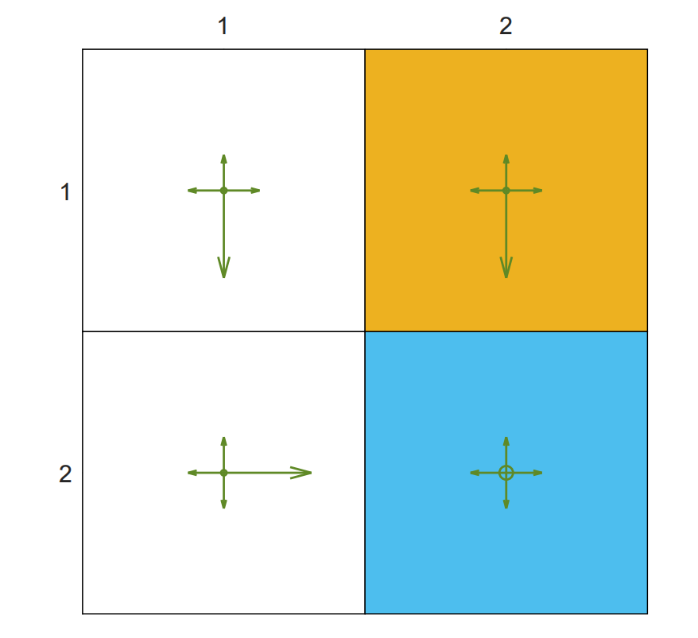
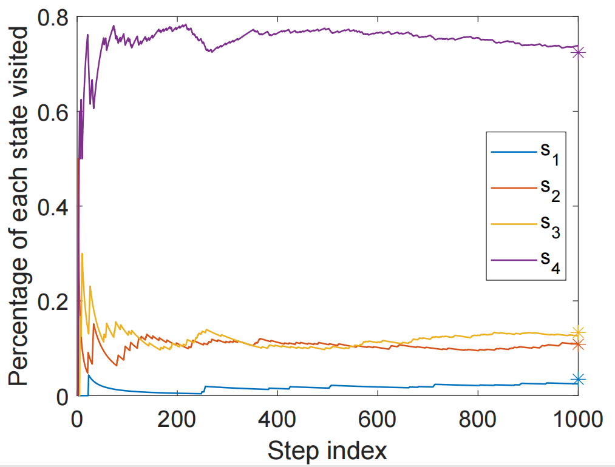
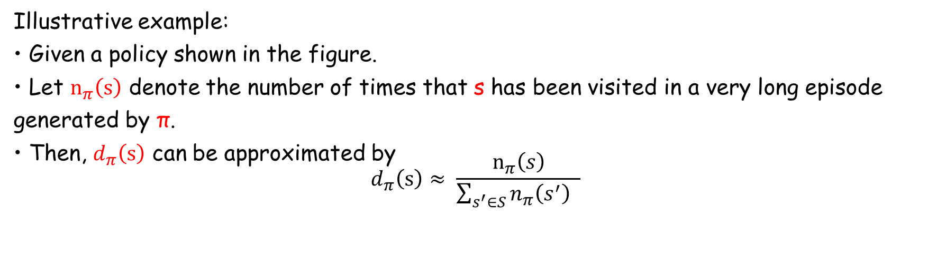
Objective function - stationary distribution
Illustrative example:
• Given a policy shown in the figure.
• Let $n_{π}\left(s\right)$ denote the number of times that s has been visited in a very long episode generated by π.
• Then, $d_{π}\left(s\right)$ can be approximated by
$$d_{π}\left(s\right)≈ \frac{n_{π}\left(s\right)}{\sum_{s^{′}∈S}{n_{π}\left(s^{′}\right)} }$$
Figure: Long-run behavior of an ε-greedy policy with ε = 0.5

Slide 17
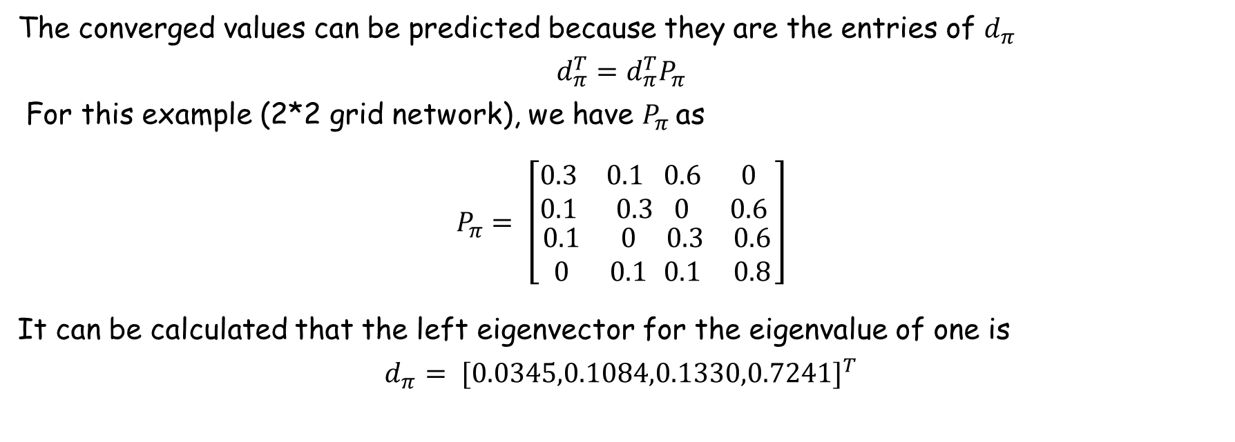

Objective function - stationary distribution
对比下：
$v_{π}=r_{π}+γP_{π}$ $v_{π}$
The converged values can be predicted because they are the entries of $d_{π}$
$$d_{π}^{T}=d_{π}^{T}P_{π}$$
For this example (2*2 grid network), we have $P_{π}$as
$$P_{π}= \left[\begin{aligned}\begin{matrix}0.3 & 0.1 \\ 0.1 & 0.3\end{matrix}\begin{matrix}0.6 & 0 \\ 0 & 0.6\end{matrix} \\ \begin{matrix}0.1 & 0 \\ 0 & 0.1\end{matrix} \begin{matrix} 0.3 & 0.6 \\ 0.1 & 0.8\end{matrix}\end{aligned}\right]$$
It can be calculated that the left eigenvector for the eigenvalue of one is
$$d_{π}= {[0.0345,0.1084,0.1330,0.7241]}^{T}$$

Slide 18
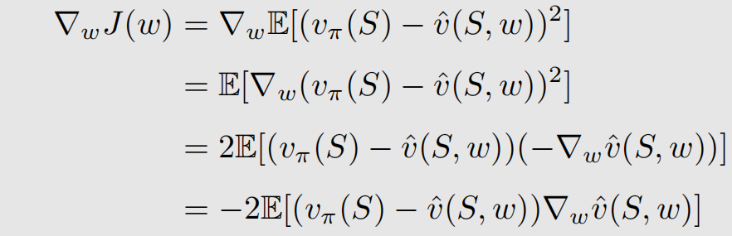
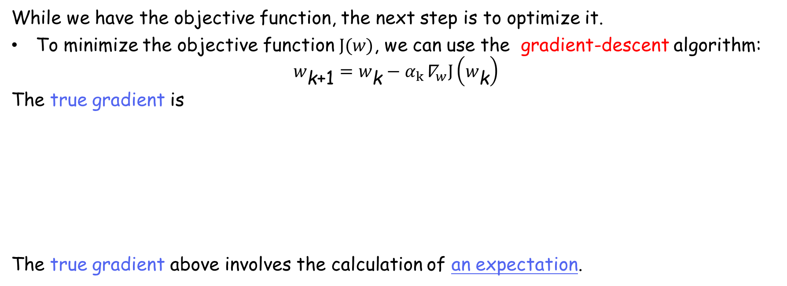
Optimization algorithm
While we have the objective function, the next step is to optimize it.
To minimize the objective function $J(w)$, we can use the gradient-descent algorithm:
$$w_{\text{k}\text{+1}}=w_{\text{k}}−α_{k}{\text{∇}}_{w}J\left(w_{\text{k}}\right)$$
The true gradient is
The true gradient above involves the calculation of an expectation.

Slide 19
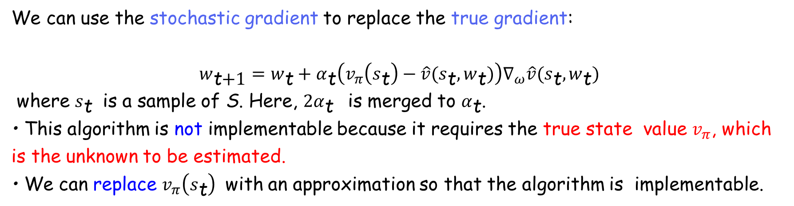

Optimization algorithm
$$w_{\text{k}\text{+1}}=w_{\text{k}}−α_{k}{\text{∇}}_{w}J\left(w_{\text{k}}\right)$$
We can use the stochastic gradient to replace the true gradient:
$$w_{\text{t}\text{+1}}=w_{\text{t}}+α_{\text{t}}\left(v_{π}\left(s_{\text{t}}\right)−\hat{v}(s_{\text{t}},w_{\text{t}})\right)∇_{ω}\hat{v}(s_{\text{t}},w_{\text{t}})$$
where $s_{\text{t}}$ is a sample of S. Here, ${2α}_{\text{t}}$ is merged to $α_{\text{t}}$.
• This algorithm is not implementable because it requires the true state value $v_{π}$, which is the unknown to be estimated.
• We can replace $v_{π}\left(s_{\text{t}}\right)$ with an approximation so that the algorithm is implementable.

Slide 20
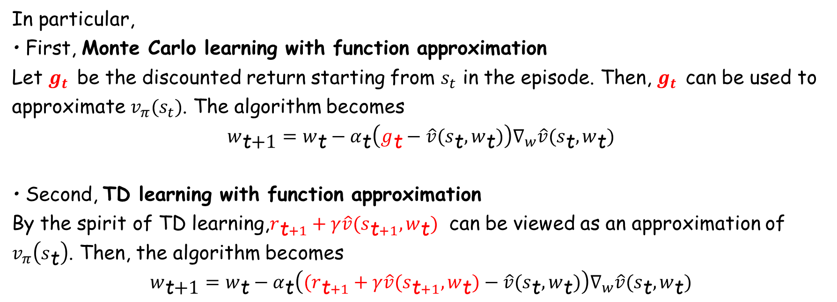
Optimization algorithm
$$w_{\text{t}\text{+1}}=w_{\text{t}}+α_{\text{t}}\left(v_{π}\left(s_{\text{t}}\right)−\hat{v}\left(s_{\text{t}},w_{\text{t}}\right)\right)∇_{ω}\hat{v}(s_{\text{t}},w_{\text{t}})$$
In particular,
• First, Monte Carlo learning with function approximation
Let $g_{t}$ be the discounted return starting from $s_{t}$ in the episode. Then, $g_{t}$ can be used to approximate $v_{π}(s_{t})$. The algorithm becomes
$$w_{\text{t}\text{+1}}=w_{\text{t}}−α_{\text{t}}\left(g_{\text{t}}−\hat{v}(s_{\text{t}},w_{\text{t}})\right)∇_{w}\hat{v}(s_{\text{t}},w_{\text{t}})$$
• Second, TD learning with function approximation
By the spirit of TD learning,$r_{\text{t}+1}+γ\hat{v}(s_{\text{t}+1},w_{\text{t}})$ can be viewed as an approximation of $v_{π}\left(s_{\text{t}}\right)$. Then, the algorithm becomes
$$w_{\text{t}\text{+1}}=w_{\text{t}}−α_{\text{t}}\left((r_{\text{t}+1}+γ\hat{v}(s_{\text{t}+1},w_{\text{t}})−\hat{v}(s_{\text{t}},w_{\text{t}})\right)∇_{w}\hat{v}(s_{\text{t}},w_{\text{t}})$$

Slide 21
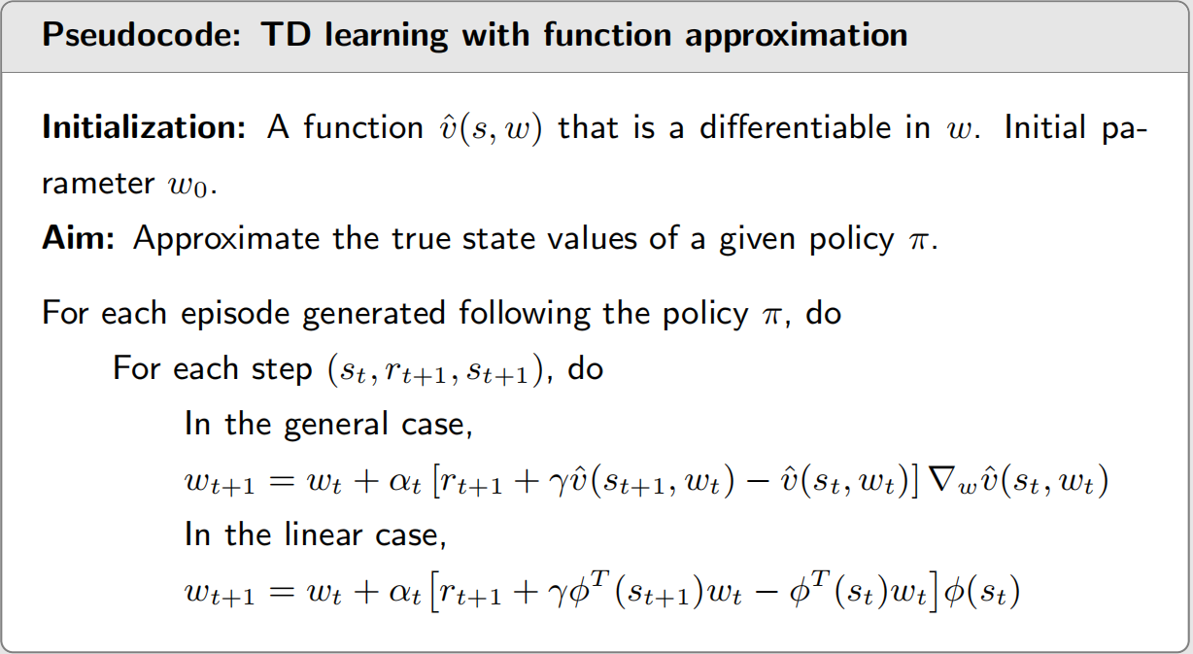
Optimization algorithm
每次采样
update参数，实现目标函数最优。
It can only estimate the state values of a given policy, but it is important to understand other algorithms introduced later.

Slide 22
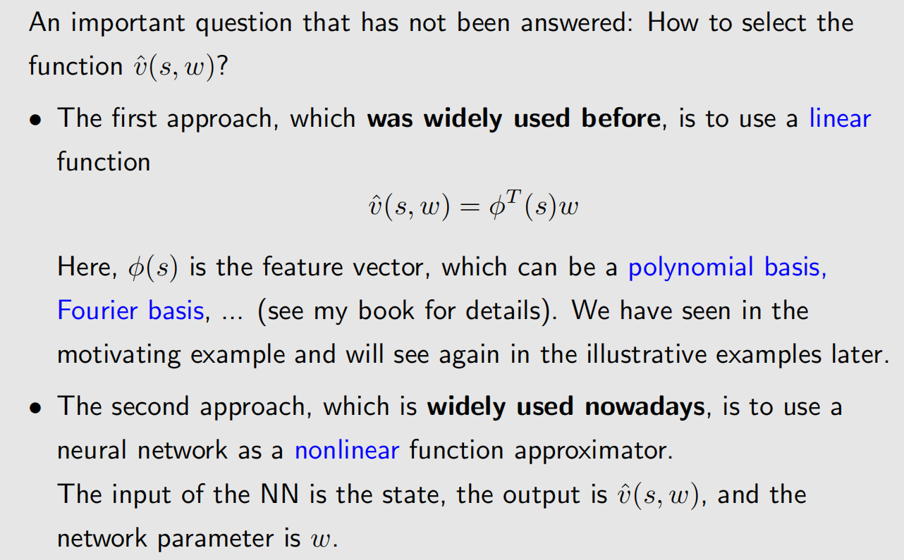
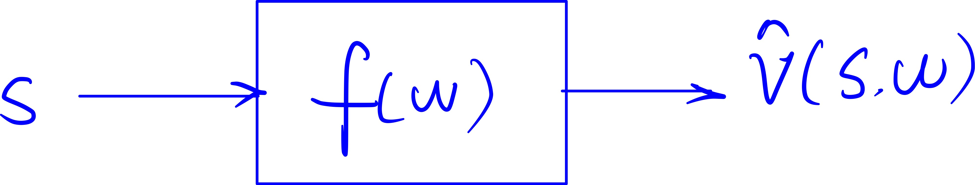
Selection of function approximators

Slide 23
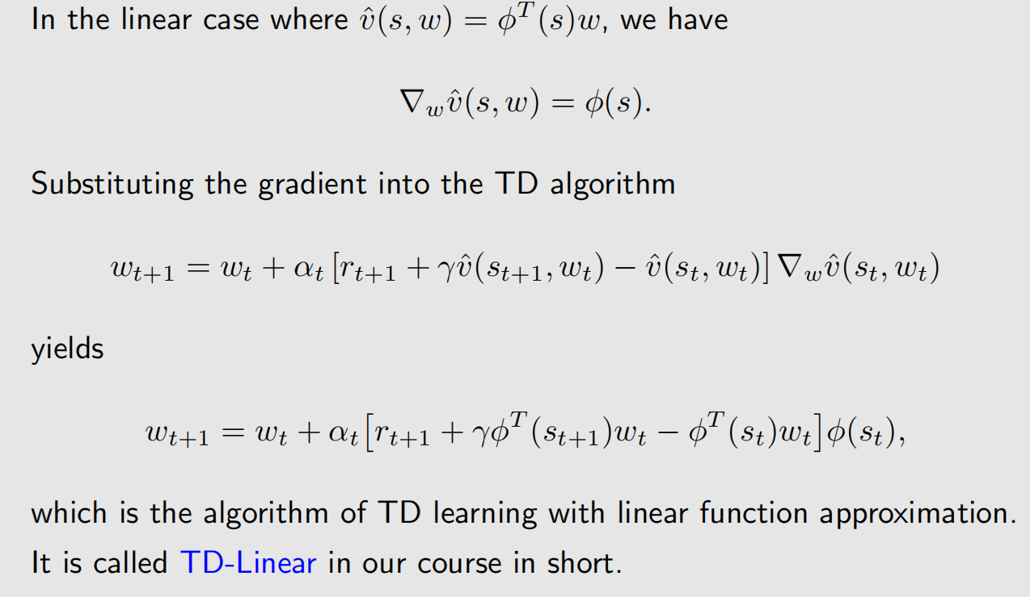
Linear function approximation

Slide 24
Linear function approximation
Disadvantages of linear function approximation:
Difficult to select appropriate feature vectors. (难！类似深度学习 取代 传统机器学习)
Advantages of linear function approximation:
The theoretical properties of the TD algorithm in the linear case can be much better understood than in the nonlinear case. (容易理论分析)
Linear function approximation is still powerful in the sense that the tabular representation is merely a special case of linear function approximation. (表征能力强，tabular的v表示可以看作是v的linear function approximation的特例)

Slide 25
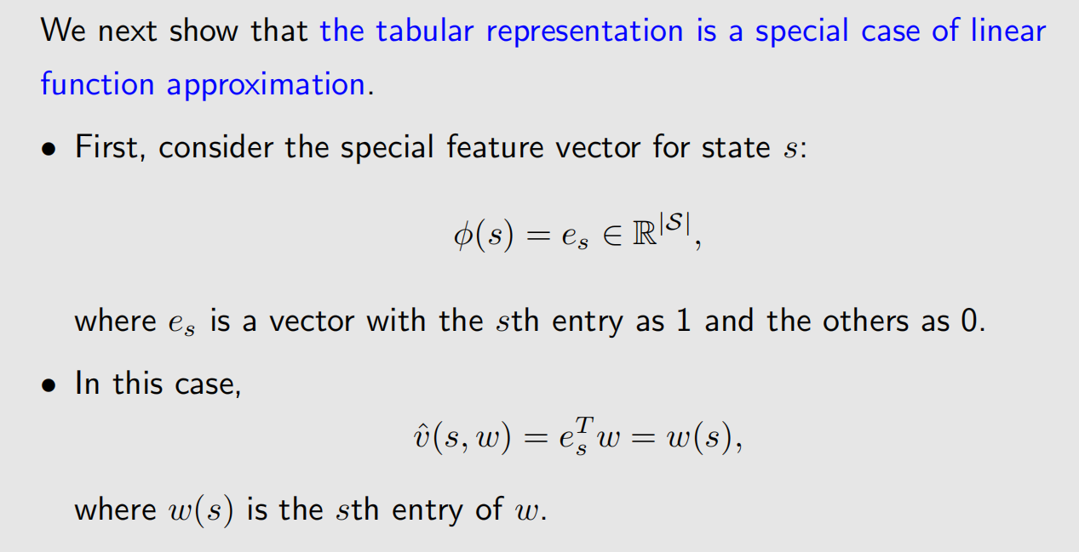
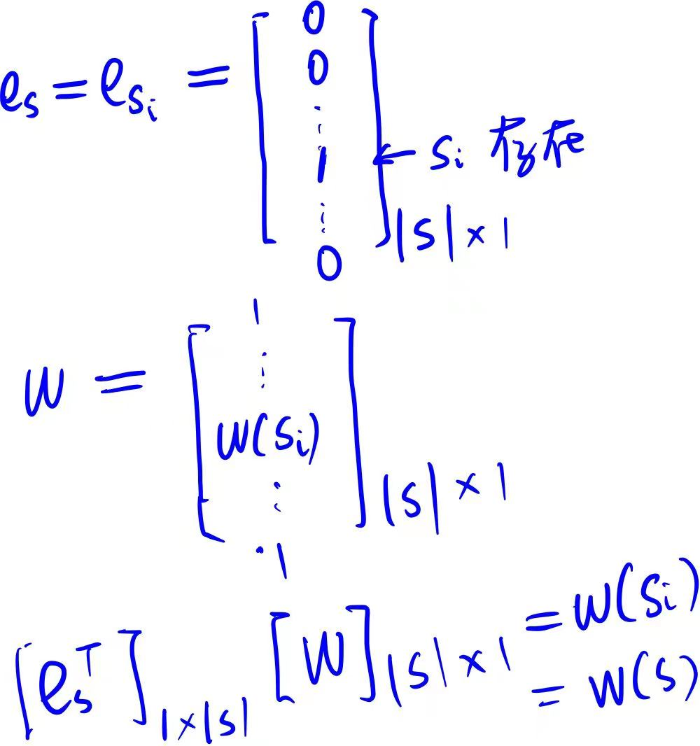
Linear function approximation
查表

Slide 26
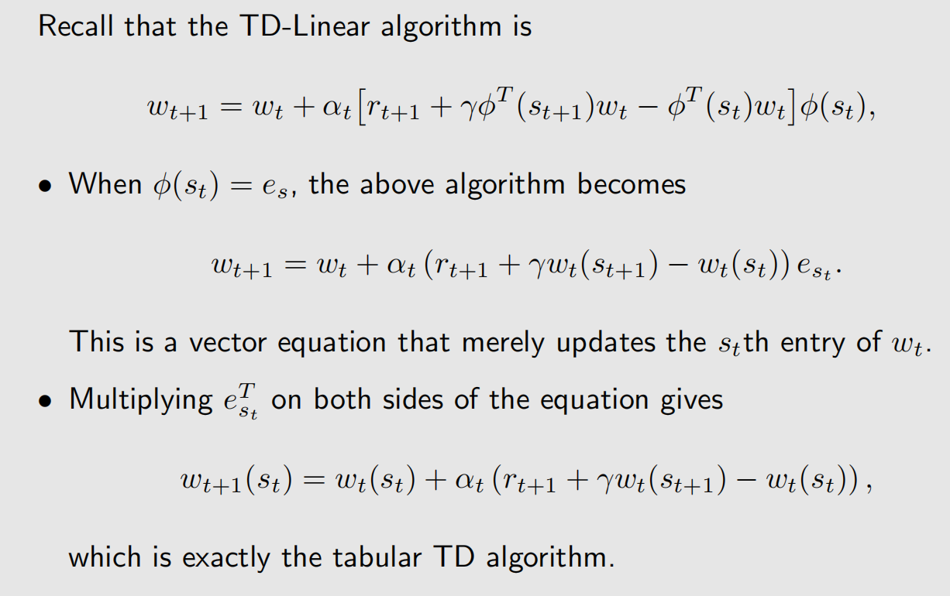
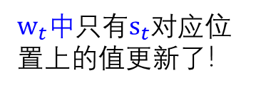
Linear function approximation
$w_{t}中$只有$s_{t}$对应位置上的值更新了！

Slide 27
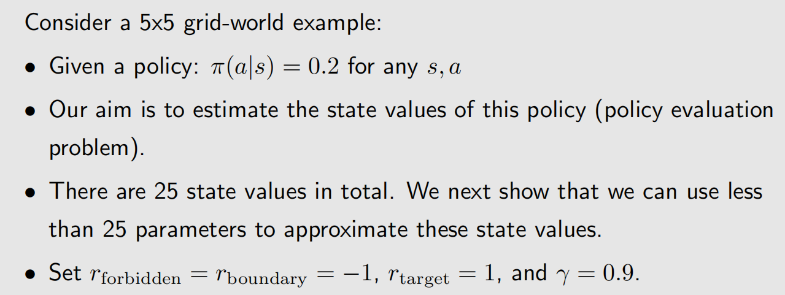
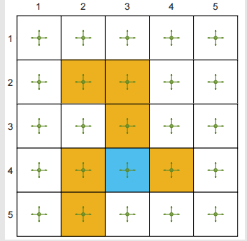

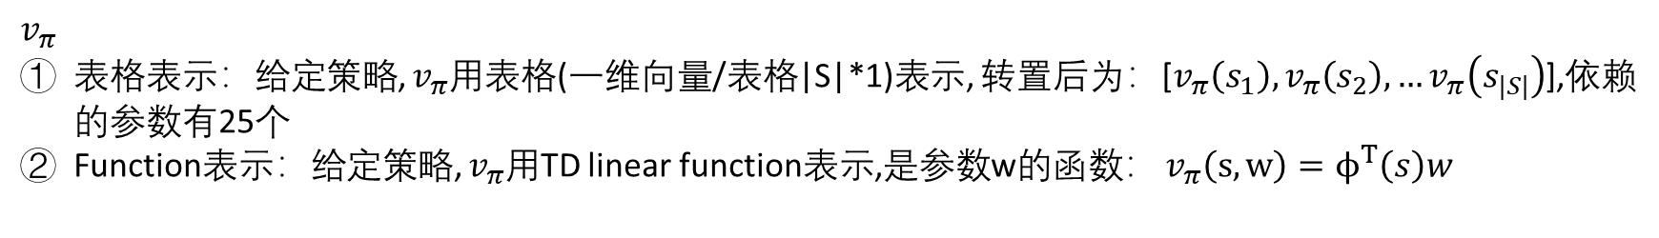
Illustrative examples
$v_{π}$
表格表示：给定策略, $v_{π}$用表格(一维向量/表格|S|*1)表示, 转置后为：[$v_{π}\left(s_{1}\right), v_{π}\left(s_{2}\right),…v_{π}\left(s_{|S|}\right)$],依赖的参数有25个
Function表示：给定策略, $v_{π}$用TD linear function表示,是参数w的函数： $v_{π}\left(s,w\right)=ϕ^{T}\left(s\right)w$
$$∧$$

Slide 28

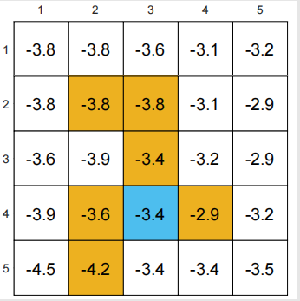
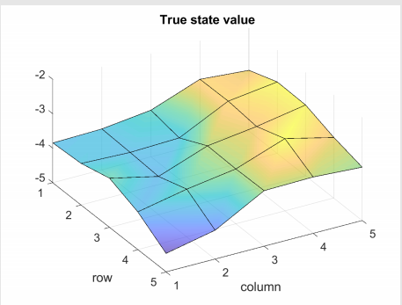
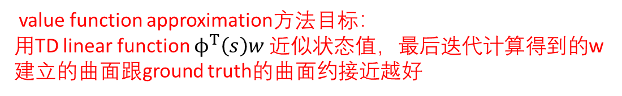
Illustrative examples
value function approximation方法目标：
用TD linear function $ϕ^{T}\left(s\right)w$ 近似状态值，最后迭代计算得到的w建立的曲面跟ground truth的曲面约接近越好
Model-based 求解Bellman方程
Ground truth:
• The true state values and the 3D visualization
Experience samples: from replay buffer
• 500 episodes were generated following the given policy.
• Each episode has 500 steps and starts from a randomly selected state-action pair following a uniform distribution.
可视化曲面表示

Slide 29
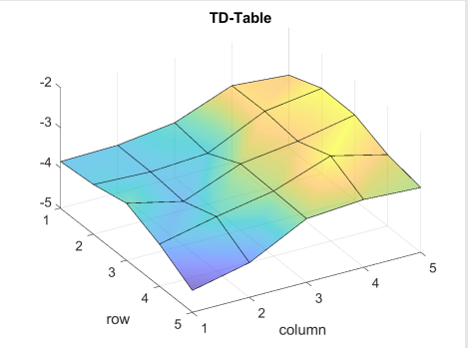
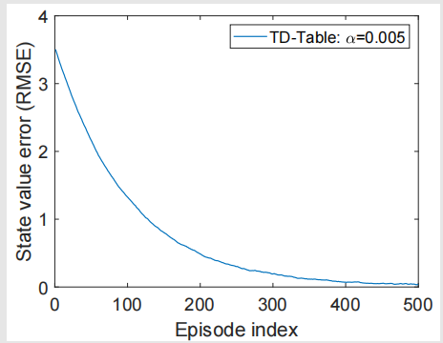
Linear function approximation
For comparison, the results given by the tabular TD algorithm (called
TD-Table in short):
Notes:
与ground truth的结果非常相近。

Slide 30
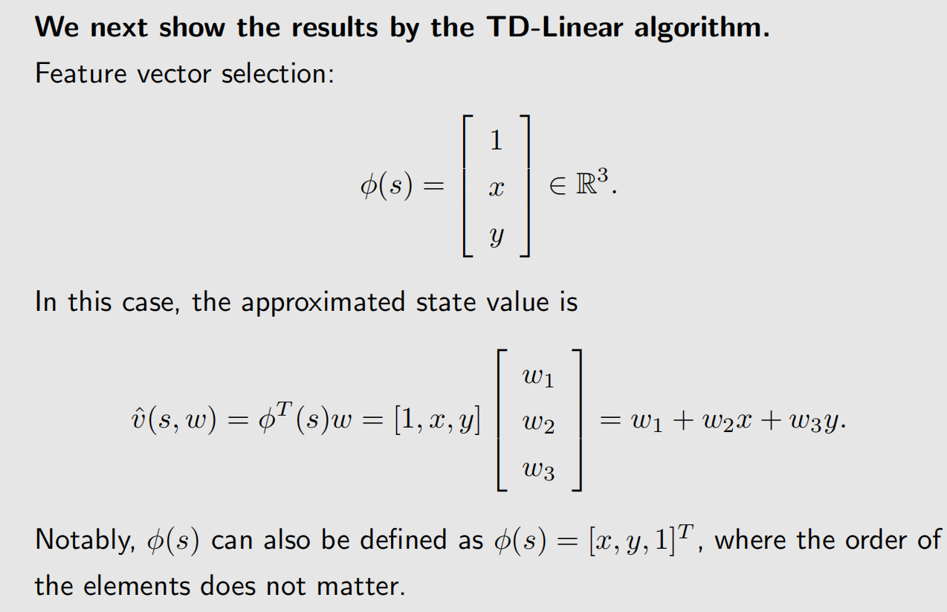
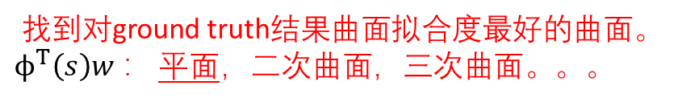
Linear function approximation
找到对ground truth结果曲面拟合度最好的曲面。$ϕ^{T}\left(s\right)w$ ： 平面，二次曲面，三次曲面。。。

Slide 31
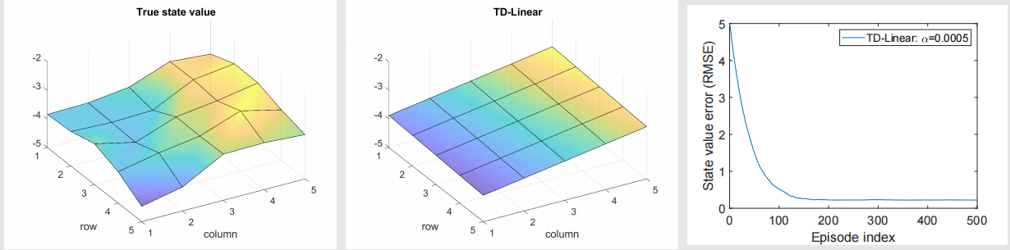
Linear function approximation
Results by the TD-Linear algorithm:
• The trend is right, but there are errors due to limited approximation ability!
• We are trying to use a plane to approximate a non-plane surface!

Slide 32
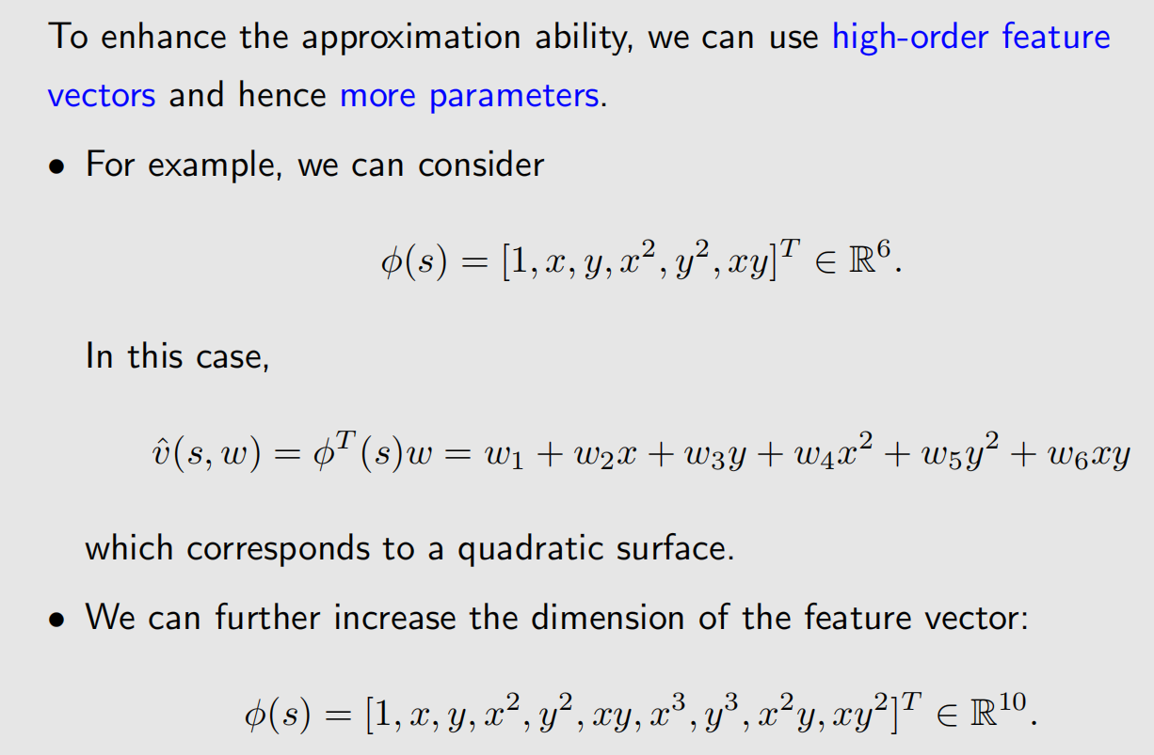
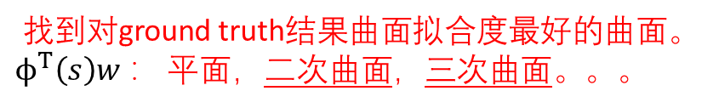
Linear function approximation
找到对ground truth结果曲面拟合度最好的曲面。$ϕ^{T}\left(s\right)w$ ： 平面，二次曲面，三次曲面。。。

Slide 33
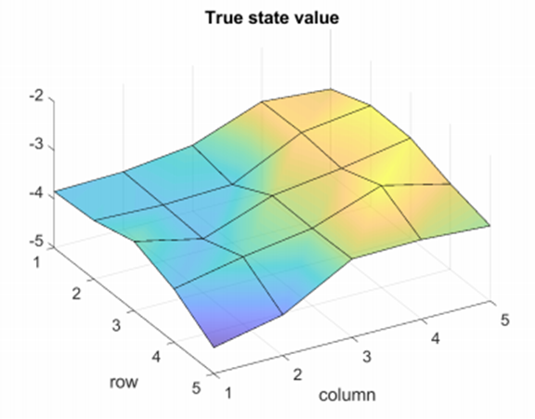
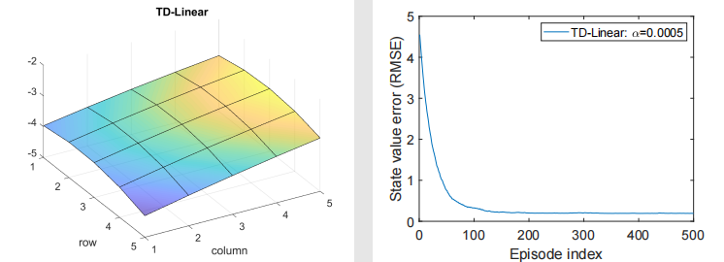
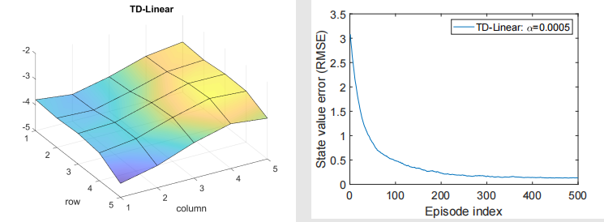
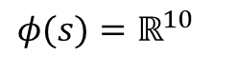
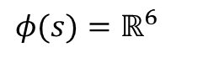
Linear function approximation
Results by the TD-Linear algorithm with higher-order feature vectors: :
More examples and types of features are given in the book of Dr. zhao.
The above figure:
$$φ(s)=ℝ^{6}$$
$$φ(s)=ℝ^{10}$$
The above figure:
Notes:
讨论下：
目前的结果表示，参数越多，拟合曲面与ground truth的曲面更一致，那么参数越多越好否？
不一定。
参数越多，复杂度就接近表格表示的RL算法，状态值估计方法复杂，且泛化性差
目前的值函数对w是线性关系，表示能力还是弱的。但是NN能近似任何一种非线性关系。

Slide 34
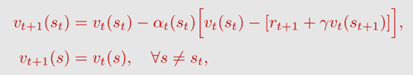
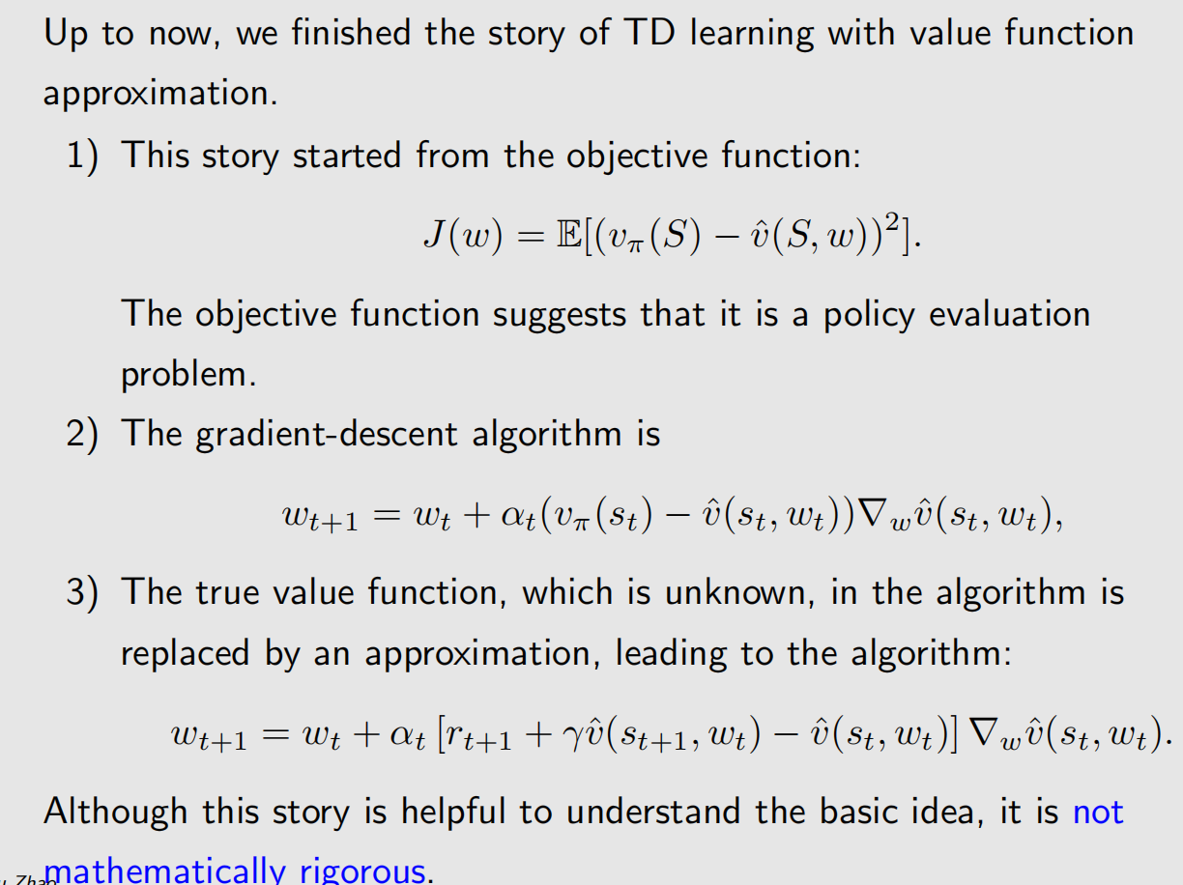
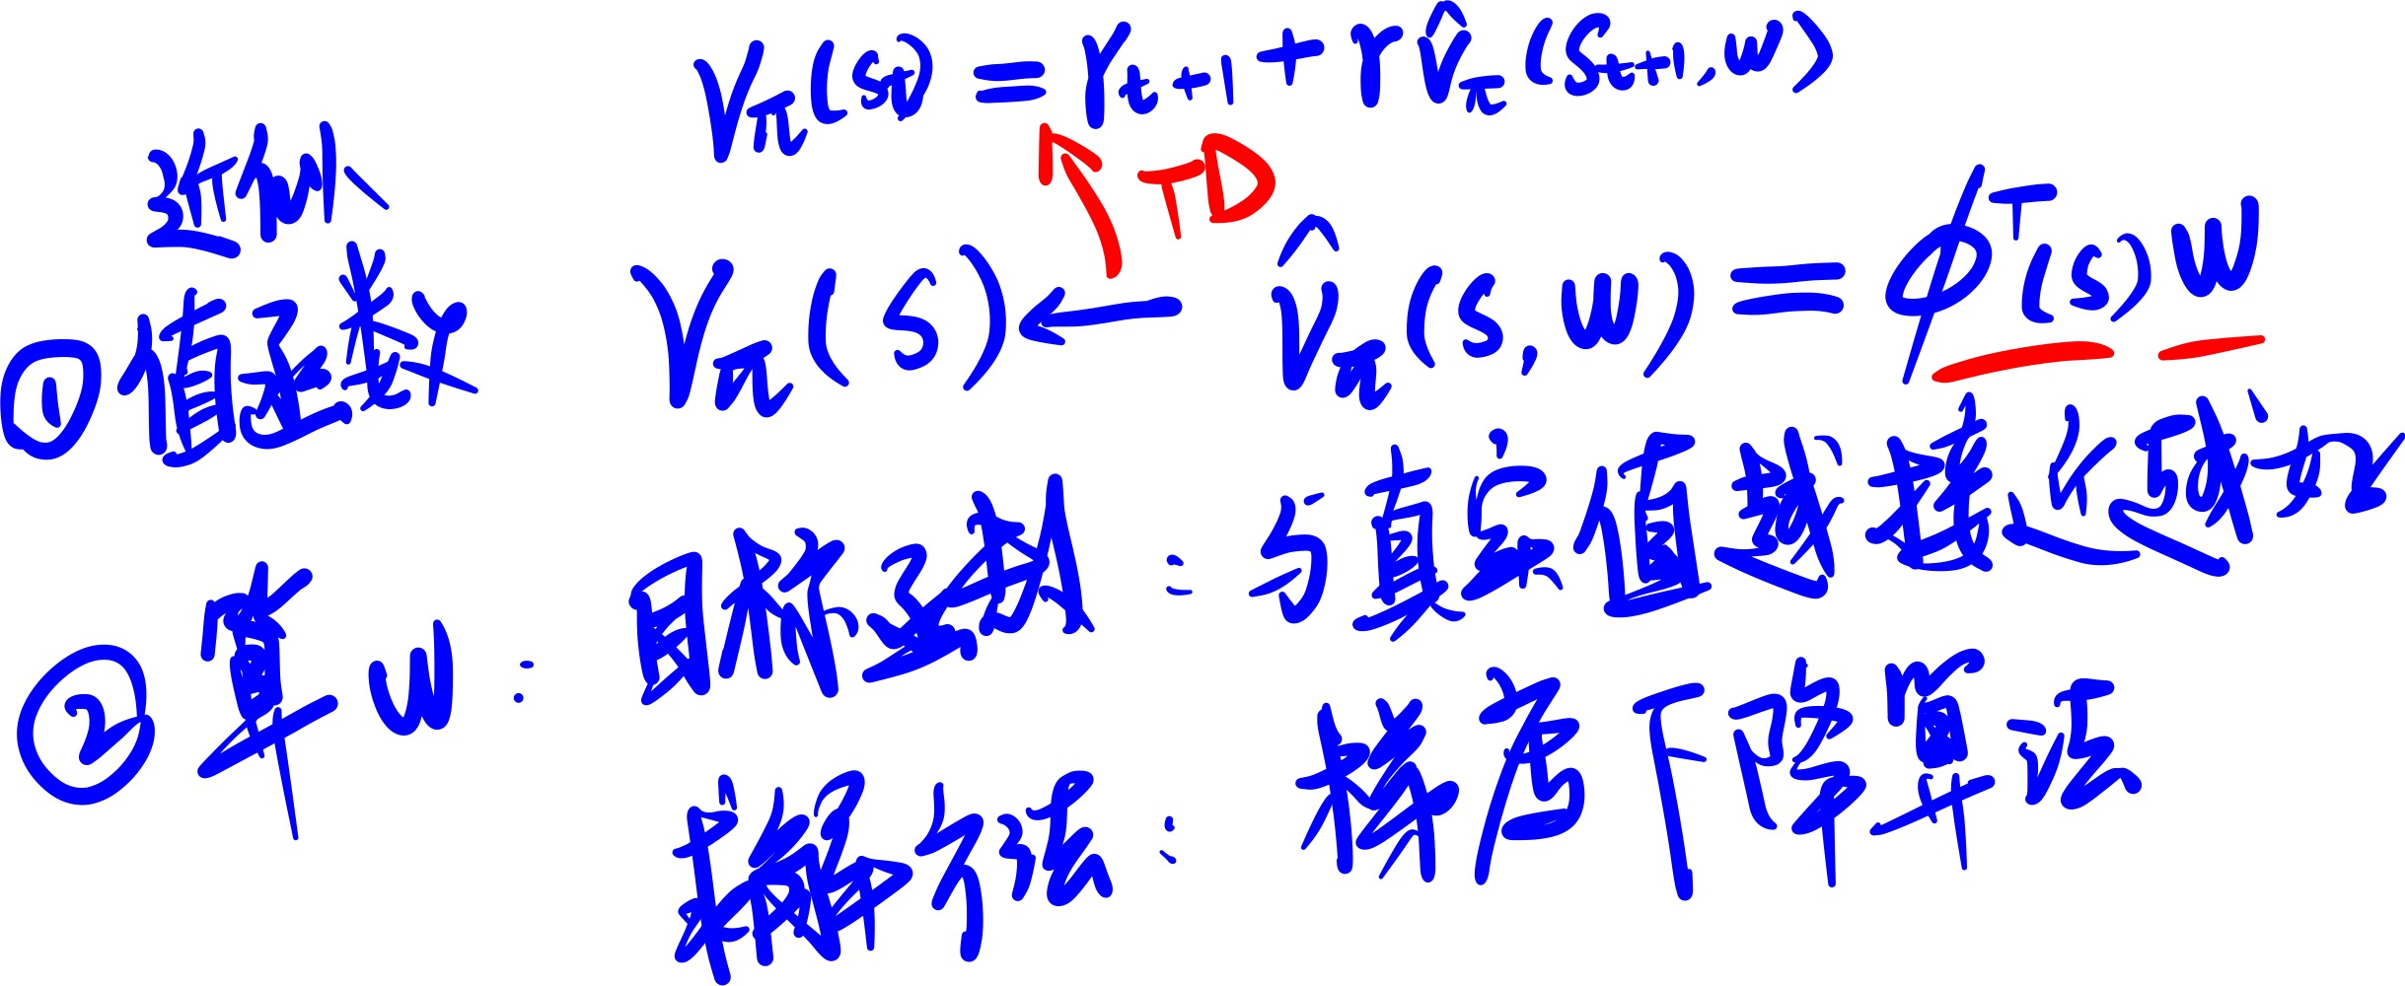
Summary of the story

Slide 35
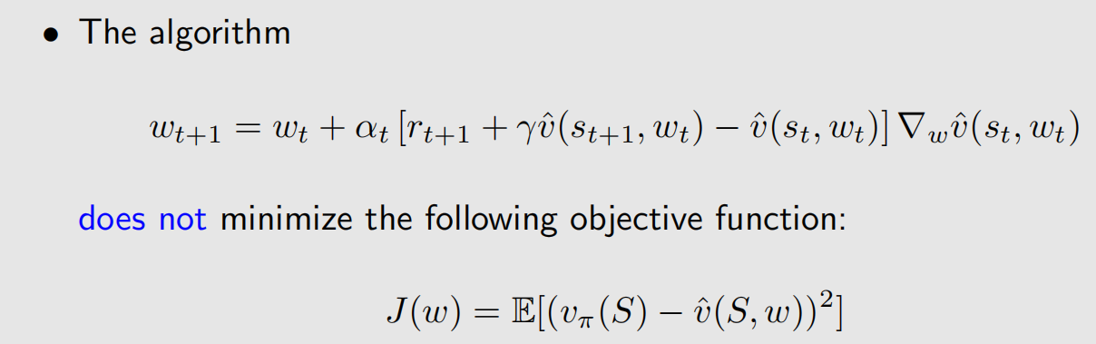
Theoretical analysis

Slide 36



Theoretical analysis

Slide 37

Theoretical analysis
趋近于0！

Slide 38
1
Motivating Examples: curve fitting
2*
Algorithm for state value estimation
action value
3
Sarsa with function approximation
4
Q-learning with function approximation
5
Deep Q-Leaning
optimal action value
6
Summary

Slide 39




Sarsa with function approximation
表格形式的q
函数形式的q

Slide 40

Sarsa with function approximation
To search for optimal policies, we can combine policy evaluation and policy improvement.

Slide 41

Sarsa with function approximation

Slide 42
1
Motivating Examples: curve fitting
2*
Algorithm for state value estimation
3
Sarsa with function approximation
4
Q-learning with function approximation
5
Deep Leaning
6
Summary

Slide 43



Q-learning with function approximation
表格形式的q
函数形式的q

Slide 44

Q-learning with function approximation
Notes:
伪代码的任务：是找到目标状态

Slide 45



Q-learning with function approximation

Slide 46
1
Motivating Examples: curve fitting
2*
Algorithm for state value estimation
3
Sarsa with function approximation
4
Q-learning with function approximation
5
Deep Q-Leaning
6
Summary

Slide 47

Deep Q-learning
在应用上取得了类人的效果，且使用了后续仍然广泛使用的技术。
神经网络的梯度，修改参数；

Slide 48

Deep Q-learning

Slide 49


Deep Q-learning

Slide 50

Deep Q-learning

Slide 51

Deep Q-learning

Slide 52


Deep Q-learning - Two networks

Slide 53

Deep Q-learning - Experience replay
收集experience是有顺序的，使用顺序如何？

Slide 54

Deep Q-learning - Experience replay
是否能确认哪些数据是重要的，哪些不是重要的？ - 先验知识

Slide 55
Deep Q-learning - Experience replay
Answer (continued):
• However, the samples are not uniformly collected because they are
generated consequently by certain policies.
• To break the correlation between consequent samples, we can use the
experience replay technique by uniformly drawing samples from the
replay buffer.
• This is the mathematical reason why experience replay is necessary
and why the experience replay must be uniform.

Slide 56
Deep Q-learning - Experience replay
Revisit the tabular case:
Question: Why does not tabular Q-learning require experience replay?
Answer: No uniform distribution requirement. 没有要求知道(s,a)的distribution
Question: Why Deep Q-learning involves distribution?
Answer: The objective function in the deep case is a scalar average over all (S, A). The tabular case does not involve any distribution of S or A. The algorithm in the tabular case aims to solve a set of equations for all (s, a) (Bellman optimality equation).
Question: Can we use experience replay in tabular Q-learning?
Answer: Yes, we can. And more sample efficient (why?)

Slide 57


Deep Q-learning - Experience replay
Remarks:
• Why no policy update?
• Why not using the policy update equation that we derived?
• The network input and output are different from the DQN paper
比较

Slide 58

Deep Q-learning - Experience replay
Illustrative example:
• This example aims to learn optimal action values for every state-action pair.
Once the optimal action values are obtained, the optimal greedy policy can be obtained immediately

Slide 59

Deep Q-learning
Notes:
函数近似具有泛化性，同时用了experience replay。

Slide 60


Deep Q-learning
What if we only use a single episode of 100 steps? Insufficient data
收敛：表示神经网络逼近了目前的样本(s,a,yT)

Slide 61
1
Motivating Examples: curve fitting
2*
Algorithm for state value estimation
3
Sarsa with function approximation
4
Q-learning with function approximation
5
Deep Leaning
6
Summary

Slide 62
Summary
This lecture introduces the method of value function approximation.
• First, understand the basic idea.
• Second, understand the basic algorithms.

Slide 63


Any Questions?

